Slide 1
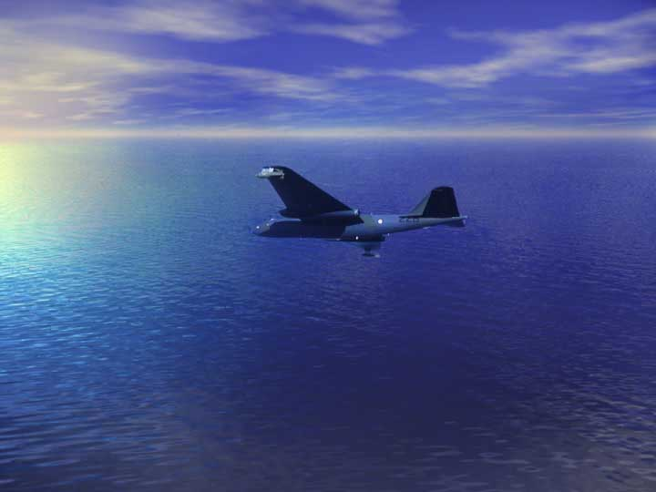
“THE PGM REVOLUTION FOR AUSTRALIA :
AIR WEAPONS PROJECTS
IN THE 1970s”
A PRESENTATION TO
THE AUSTRALIAN AVIATION CLUB
by
WING COMMANDER BOB HOWE
RAAF Retired

Slide 2
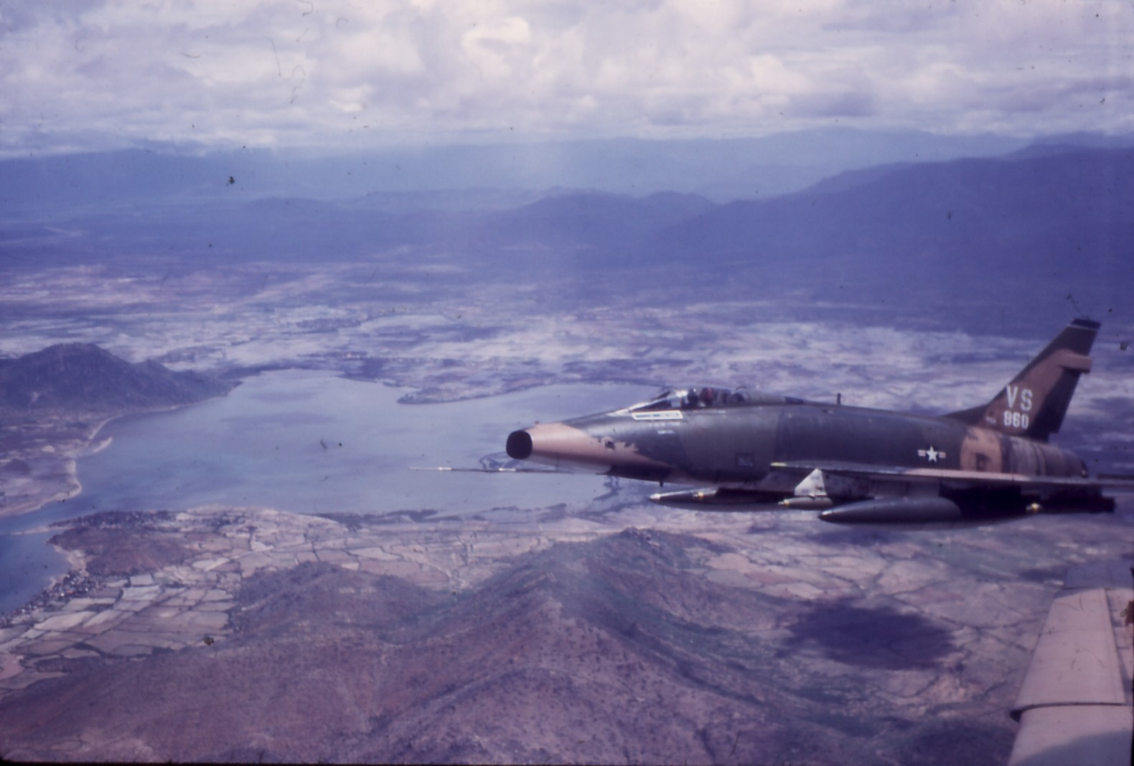
THE DUMB BOMB ERA

Slide 3
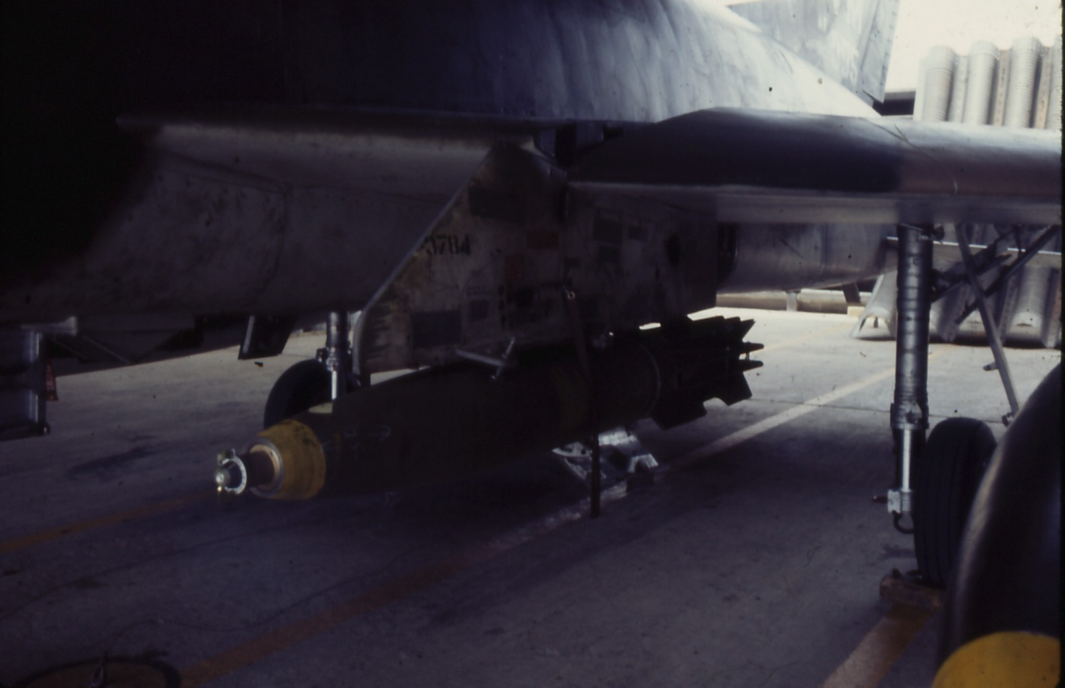

Slide 4
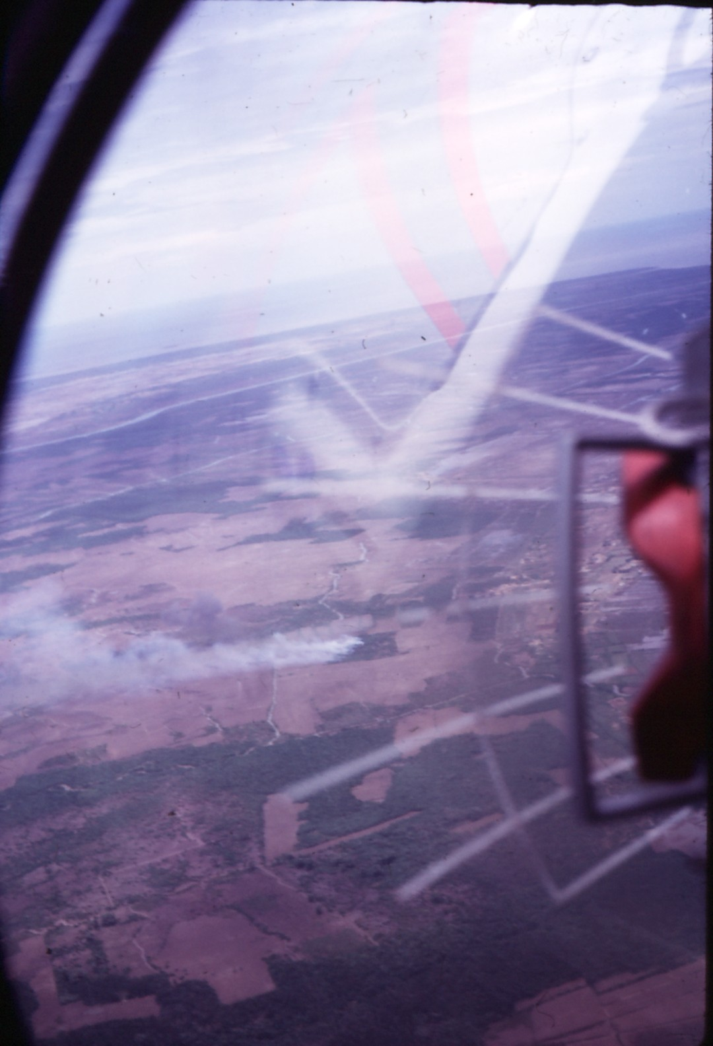

Slide 5
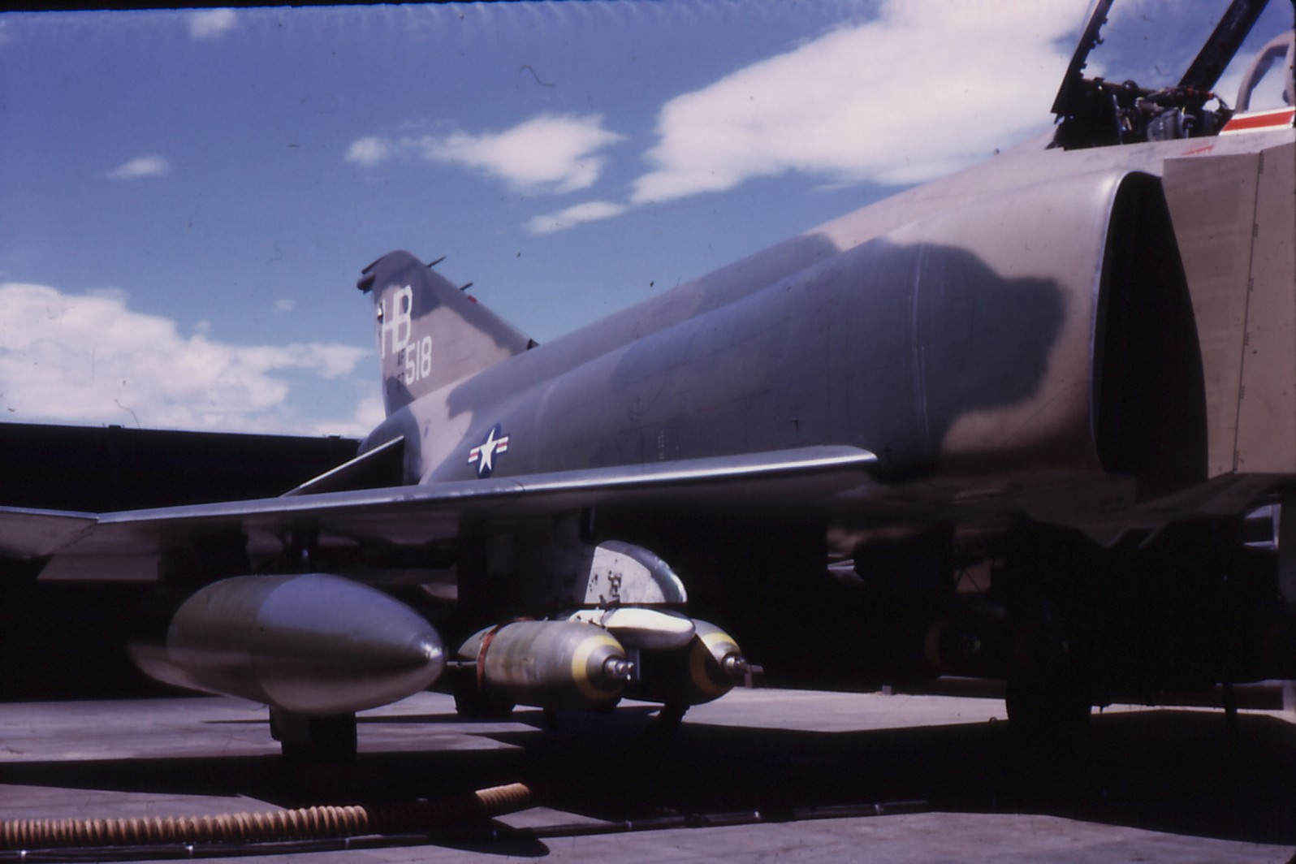

Slide 6
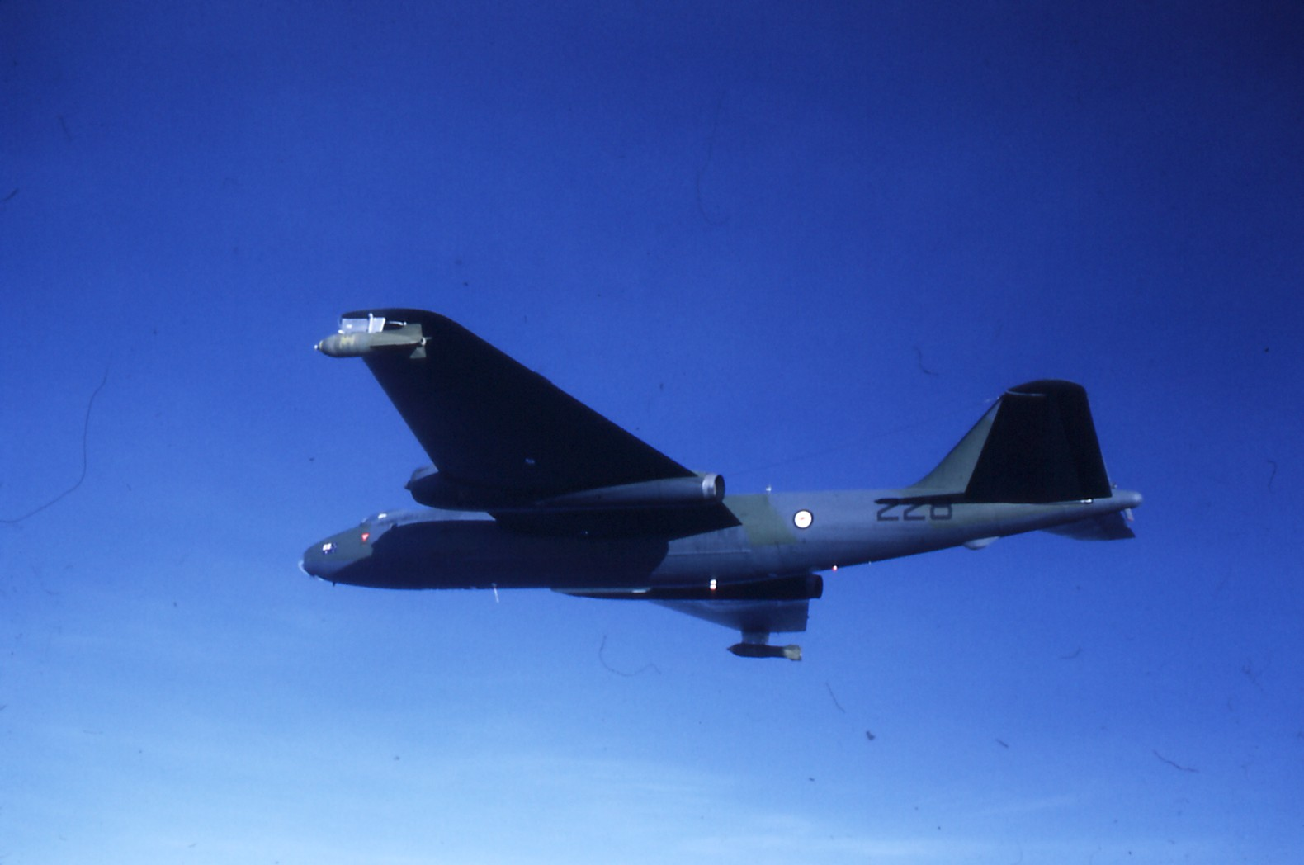

Slide 7
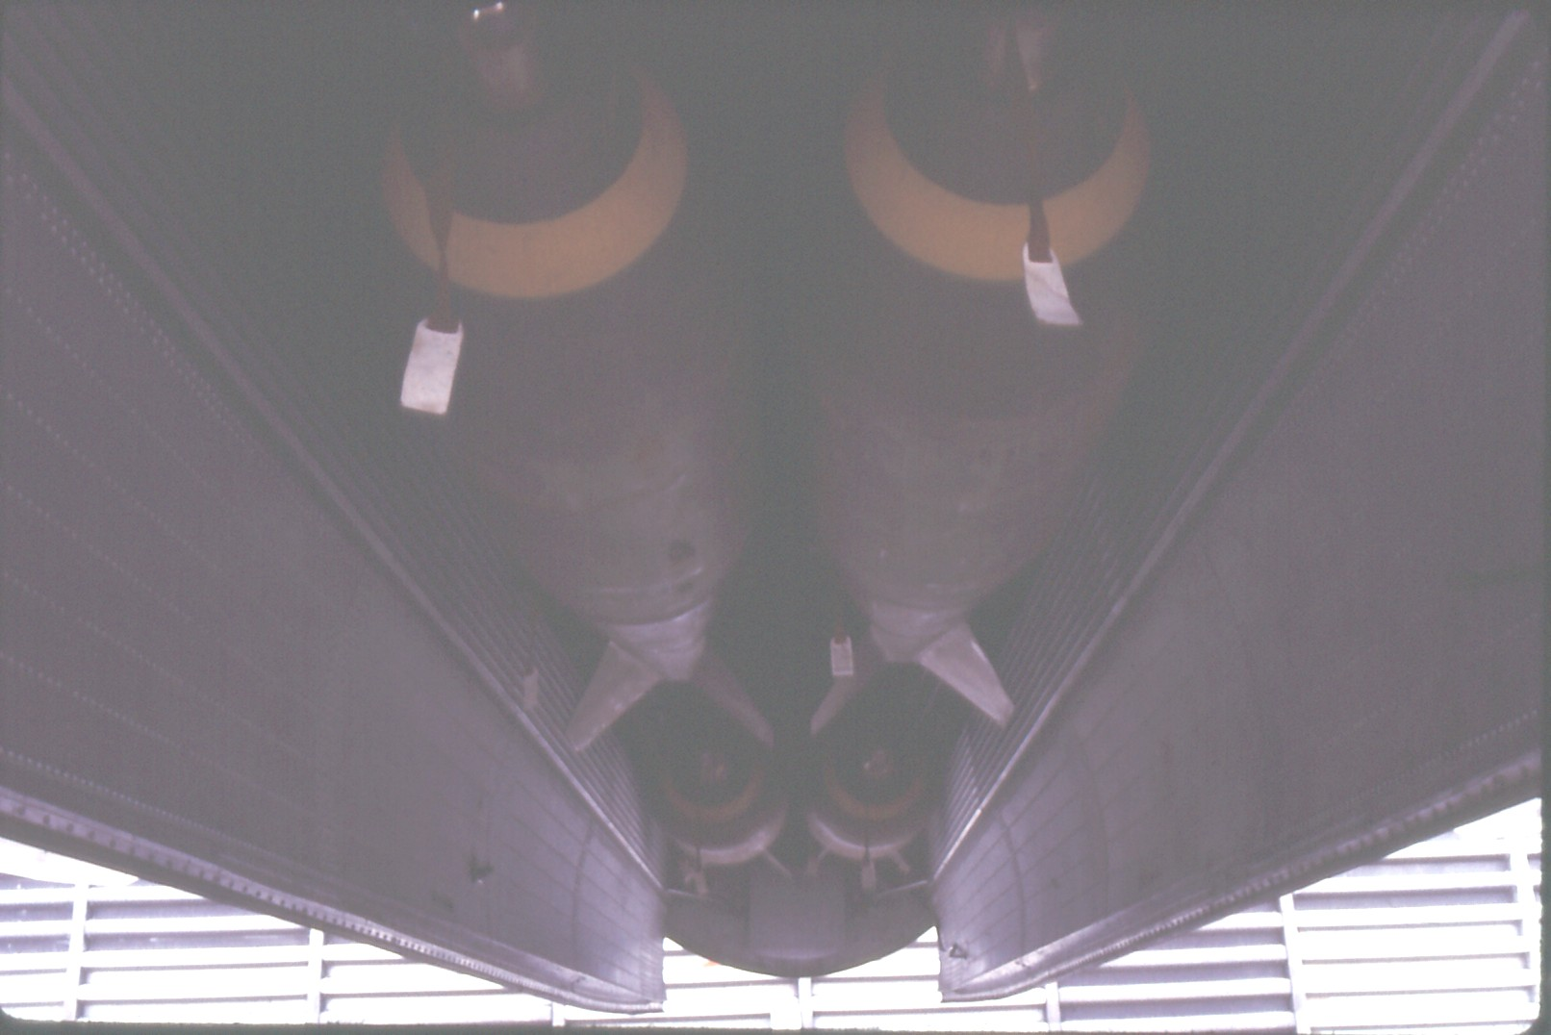

Slide 8
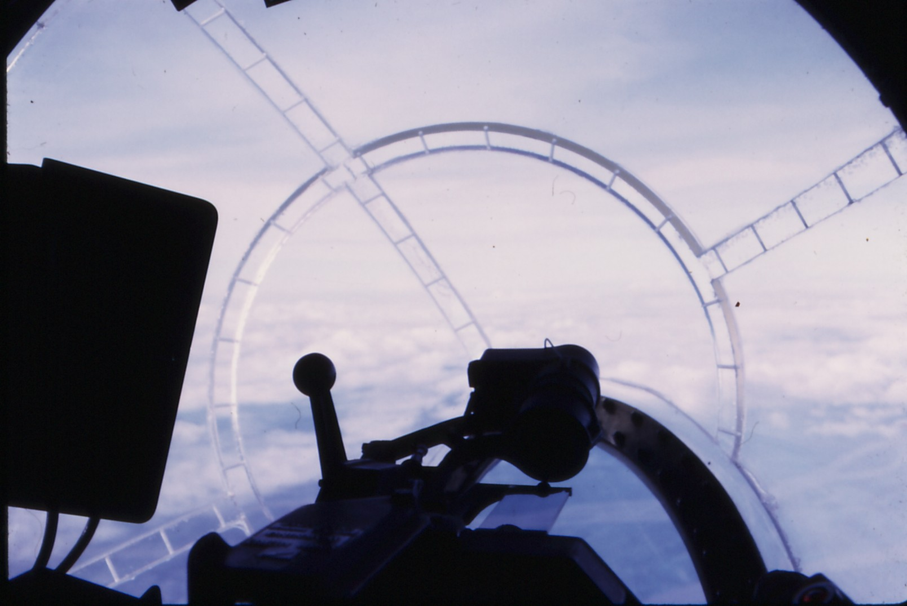

Slide 9
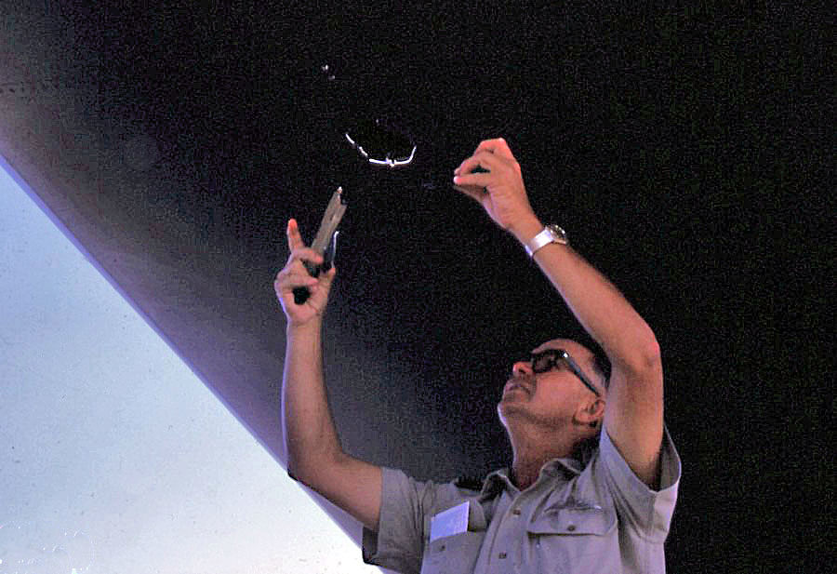

Slide 10
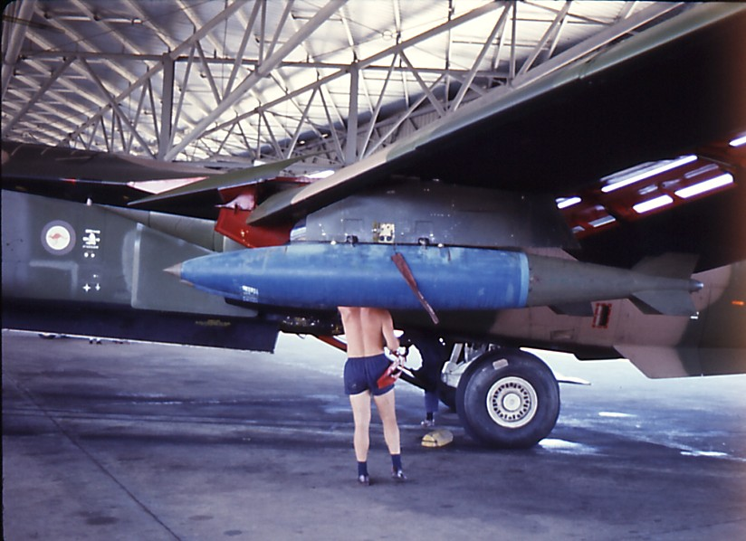

Slide 11
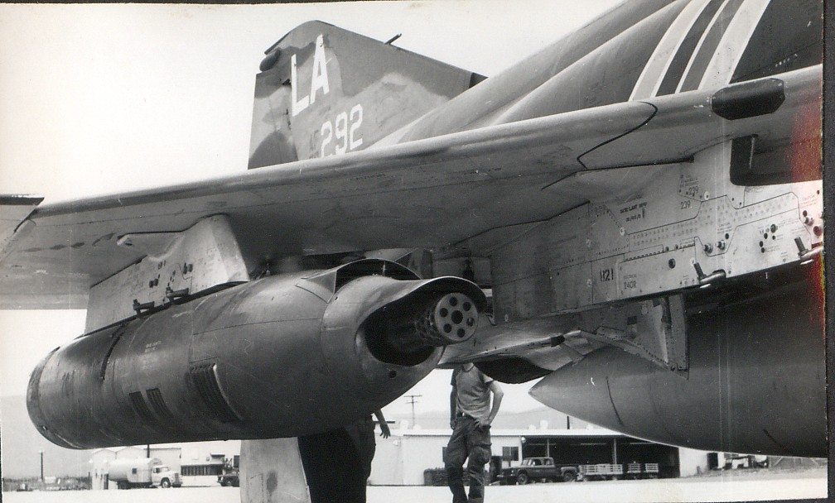

Slide 12
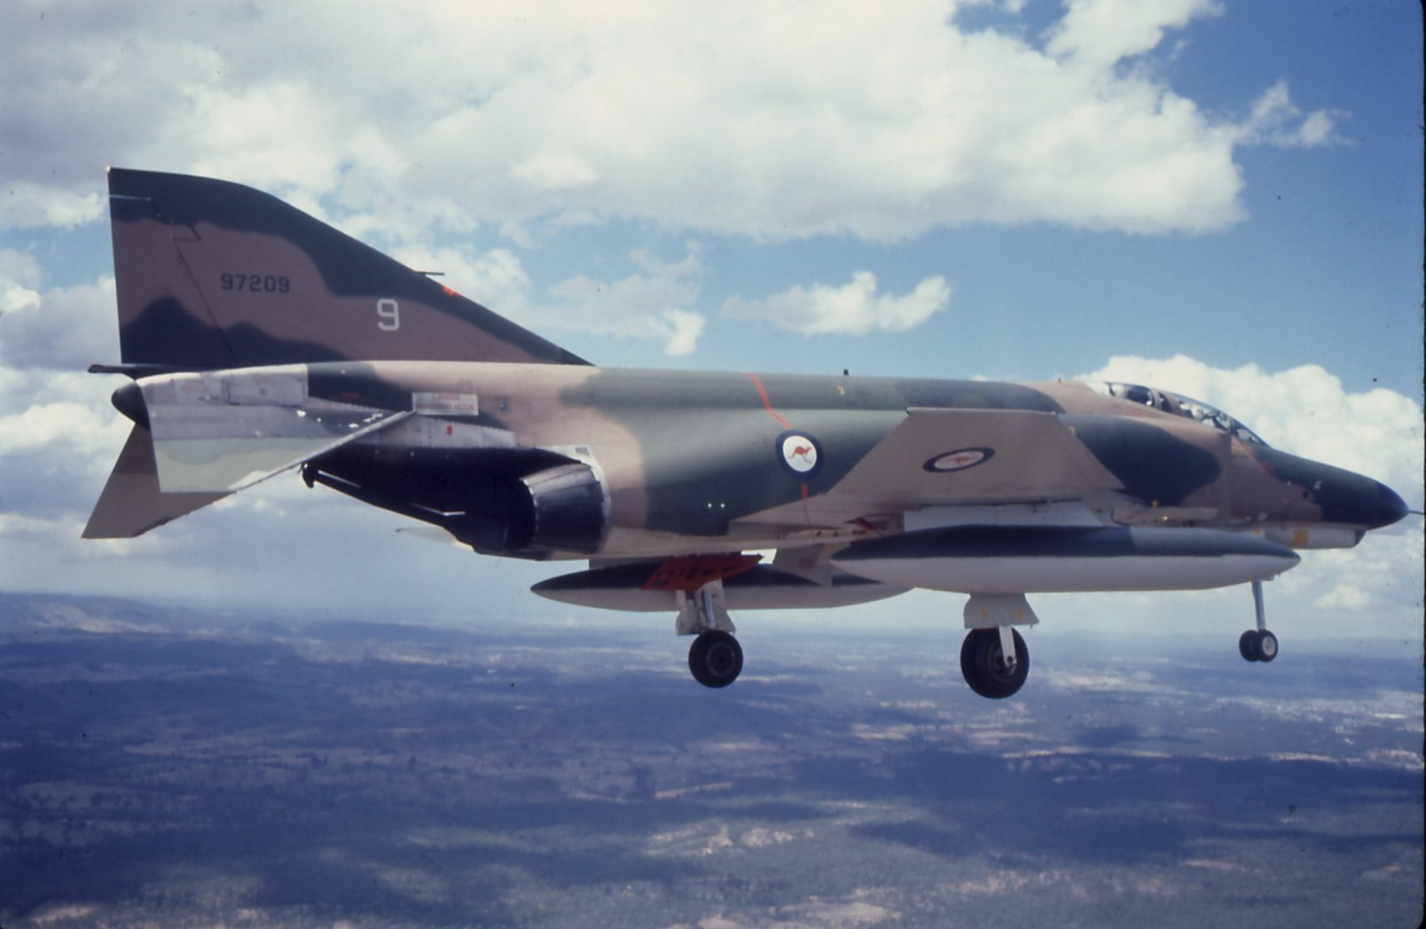

Slide 13
AIR WEAPONS PROJECTS – MID-1970s
AIR-TO-AIR MISSILES
AIR-TO-SURFACE WEAPONS
SURFACE-TO-AIR WEAPONS
INDIGENOUS PROGRAMS
AIR WEAPONS RANGES

Slide 14
AIR-TO-AIR MISSILE PROJECTS
SHORT RANGE AAM (SRAAMs) AIR 17
MEDIUM RANGE AAM (MRAAMs) AIR 21

Slide 15
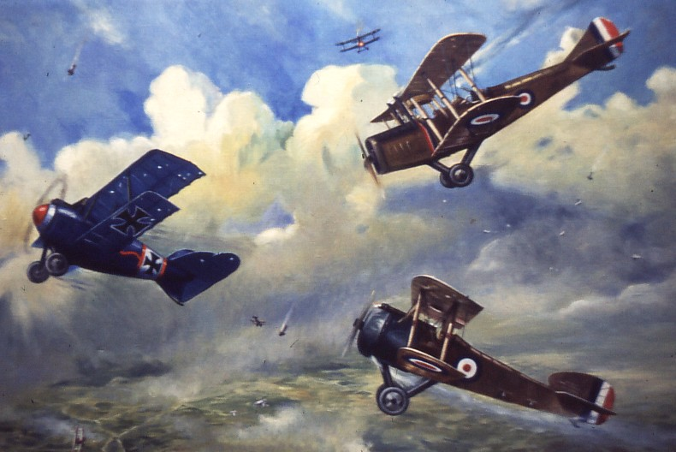
SRAAM – WVR MISSILES

Slide 16
SRAAM DEVELOPMENTS
IMPROVED IR SEEKER HEADS
OFF-BORESIGHT DETECTION
HIGH G MANEOUVRABILITY
360º NO SAFE ZONE
USAF v. USN OWNERSHIP

Slide 17
SRAAM OPTIONS
Replacing AIM-9B on Mirages, A-4s; F-111C self-defence; New Tactical Fighter
SIDEWINDER AIM-9E, -9J or -9L
OTHERS – Israeli, French

Slide 18
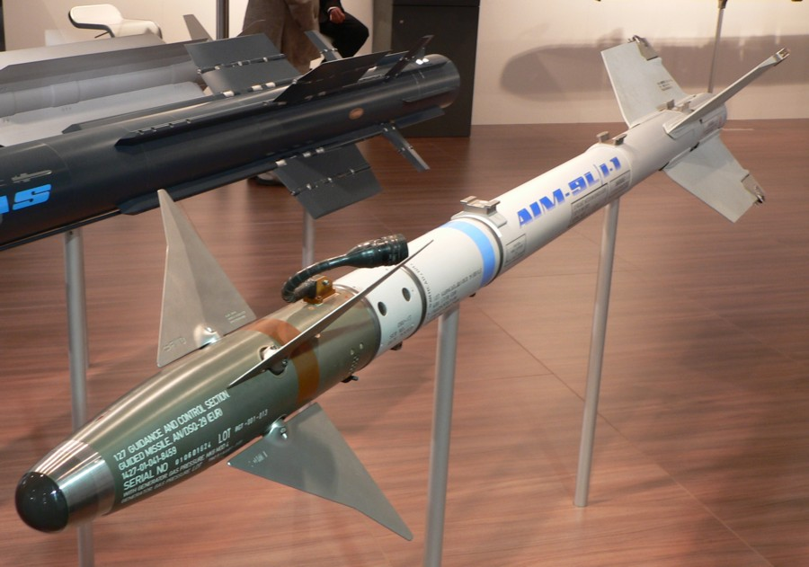
AIM-9L Sidewinder

Slide 19
MRAAM OPTIONS
REPLACING MATRA R-530
ON RAAF MIRAGES &
FOR NEW TACTICAL FIGHTER
AIM-7 SPARROW or SKYFLASH

Slide 20
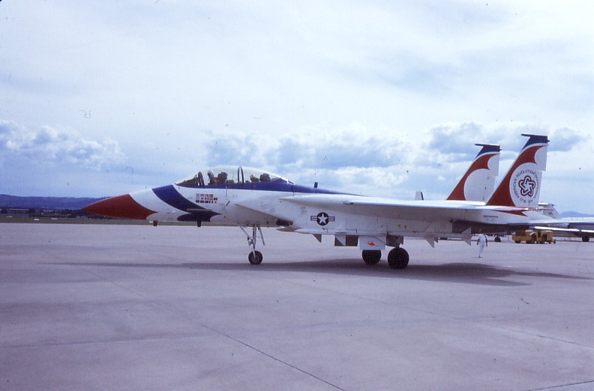
MRAAM – BVR MISSILES

Slide 21
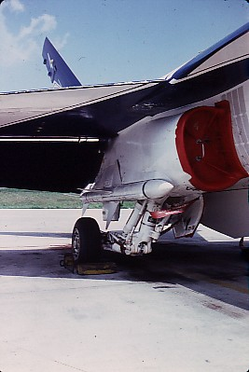
MRAAM – BVR MISSILES

Slide 22
AIR-TO-SURFACE PROJECT (AIR 58)
AIR-TO-GROUND MISSILES (AGMs)
ANTI-RADAR MISSILES (ARMs)
ELECTRO-OPTICAL GUIDANCE KITS
FOR BOMBS

Slide 23
AIR-TO-GROUND MISSILES (AGMs)
HUGHES AGM-58 MAVERICK
.......... TV guidance
.......... Infra-red guidance
.......... Laser guidance

Slide 24
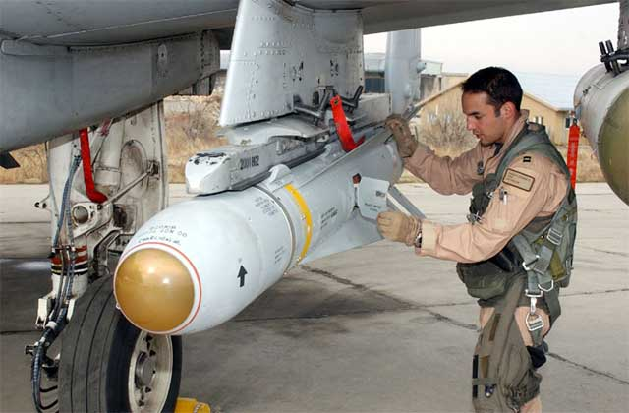

Slide 25
ANTI-RADAR MISSILES (ARMs)
Standard ARM
AIM-45 Shrike
AIM-88 High Speed Anti-radar Missile (HARM)

Slide 26
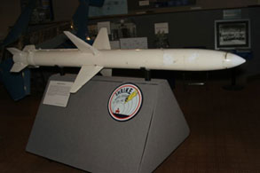

Slide 27
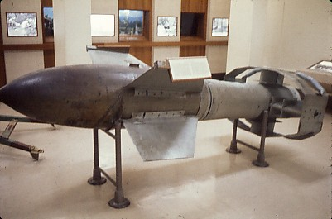
SMART BOMBS

Slide 28
SEEKER HEADS
USN WALLEYE
USAF PAVEWAY E-O COMBINATIONS
GBU-8 - 500 lb Mk 82/KMU-388
GBU-10 - 750 lb M-117/KMU-342
GBU-15 - 2000 lb Mk 84/KMU-351
GBU-12 - 3000 lb M-118/KMU-370

Slide 29
LASER ILLUMINATORS
SELF-CONTAINED
.........PAVE KNIFE/PAVE SPIKE (F-4)
.........PAVE TACK (F-111C)
REMOTE
........FAC/Fast FAC/C-130 etc

Slide 30
ANTI-SHIP MISSILES (JPB-1)
Platforms – Ships, Submarines & Aircraft (P-3, F-111, NTF)
Harpoon, Kormoran or Exocet
First generation – self-contained radar
Later generations – E-O, GPS

Slide 31
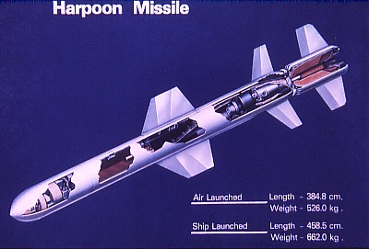

Slide 32
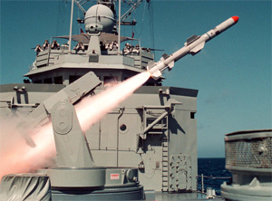

Slide 33
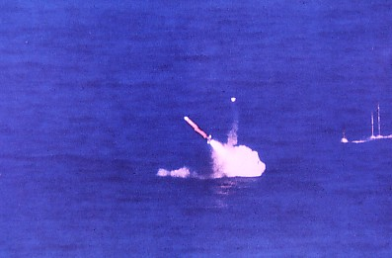

Slide 34
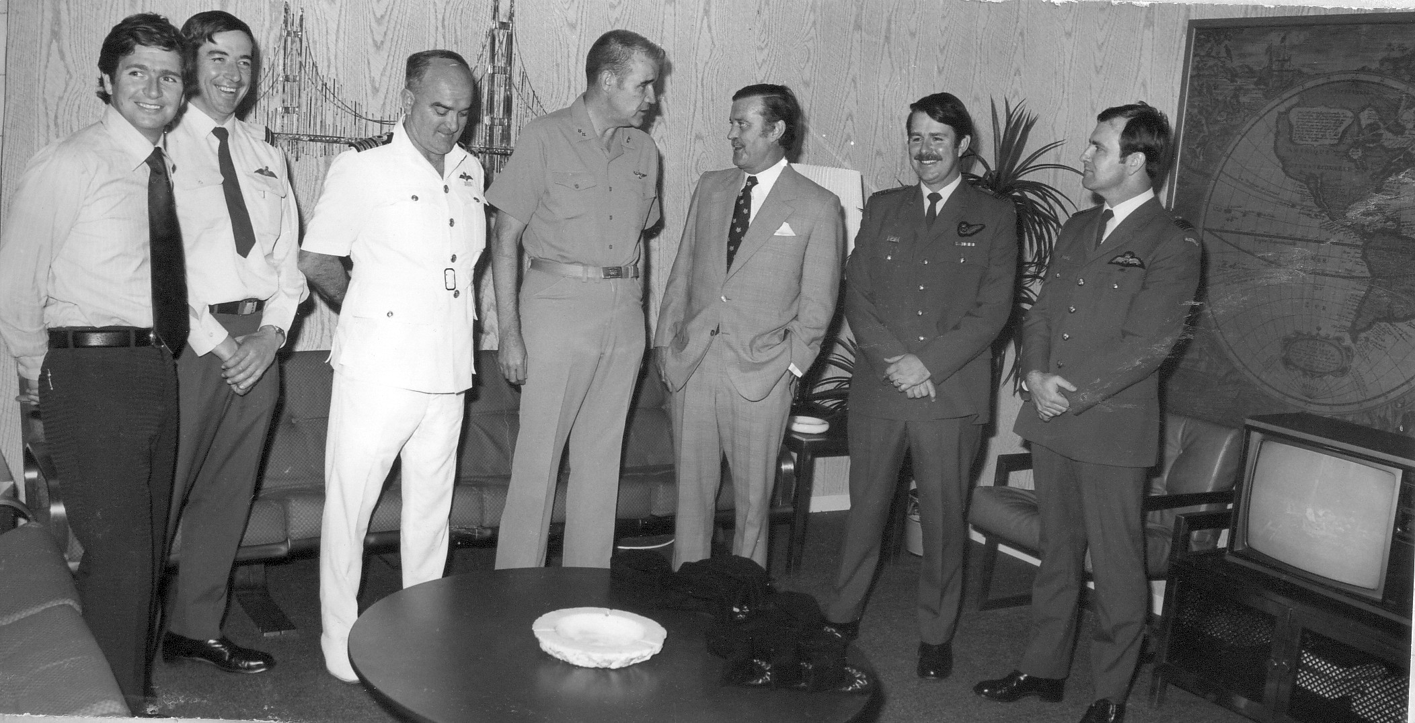

Slide 35
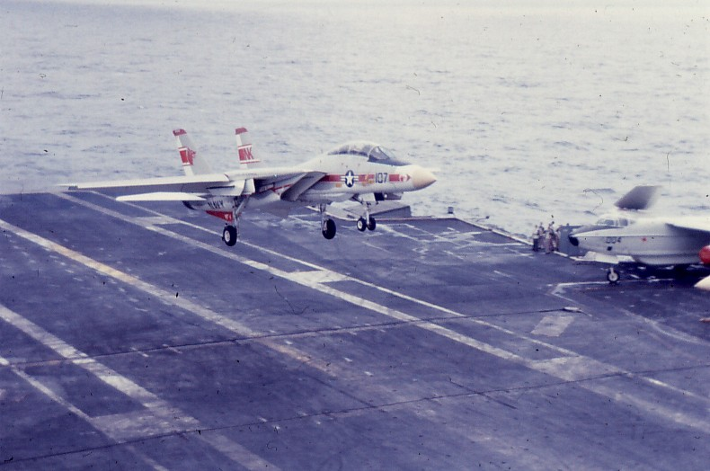

Slide 36
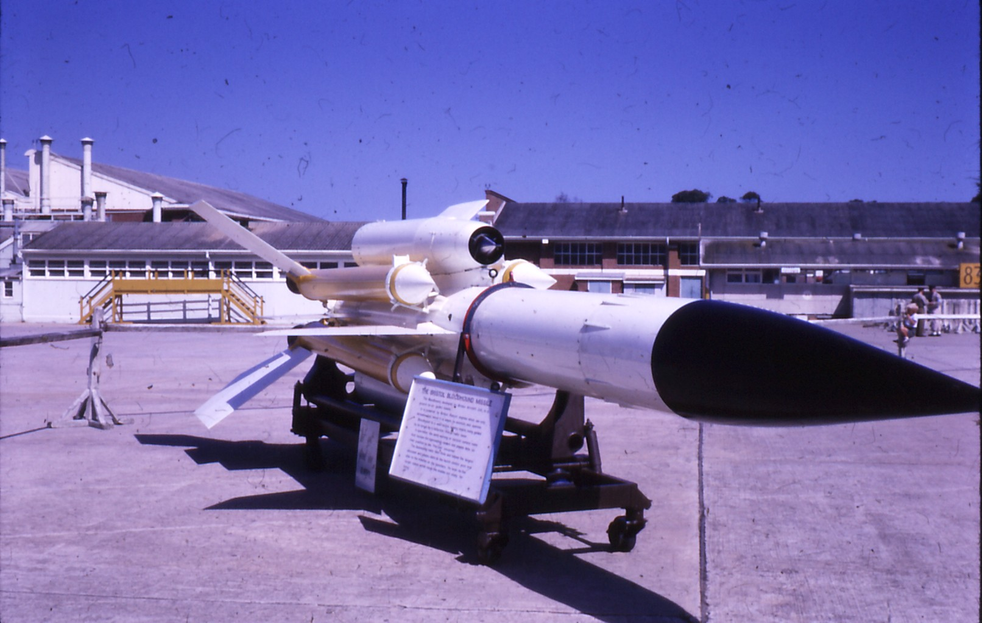
SURFACE-TO-AIR MISSILES (SAMs)

Slide 37
SURFACE-TO-AIR MISSILE
PROJECT AIR 43
Replacing Bloodhound Mk 2
Options – Improved Hawk
- SAM-D (later Patriot)
Sir Joh Bjelke-Petersen

Slide 38
INDIGENOUS PROGRAMS
Targets – air and ground
Cluster Bombs
Extended Range Guided Glide Bombs
Air Weapons Ranges

Slide 39
AIR TARGETS
Jindivik/replacement
Turana
Tonic towed target

Slide 40
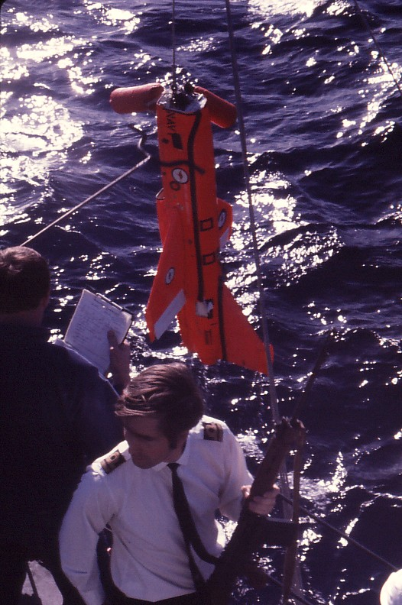

Slide 41
PROJECT KARINGA
TTCP origins – DSTO and S curve
Overseas options – CBU-52, CBU-58
Selling Karinga - Airman-to-airman talks: Woomera demo to CINCPAC
An opportunity lost

Slide 42
MODULAR GUIDED GLIDE BOMB (MGGB)
Project Kerkanya
Stan Schaetzel (Hawker de Havilland)
Extended stand-off range Mk 82 500lb
KMU-388 seeker head
Another opportunity lost

Slide 43
OTHER PROJECTS
F-111C Avionics Update – weapon v. EW systems optimisation
Army weapons projects oversight (e.g. Army 19 - VLLADS)
Navy weapons projects oversight (e.g. Navy 1022 – CIWS)

Slide 44
SUMMARY
Major technology advances
Accelerating rate of change
Increased complexity
Higher lethality
Stifled local innovation
Preceded digital-GPS era

